Slide 1

Dreamline
Brian Kopec, Cole Pearson, Harshal Patel,
Nausherwan Tirmizi

Slide 2
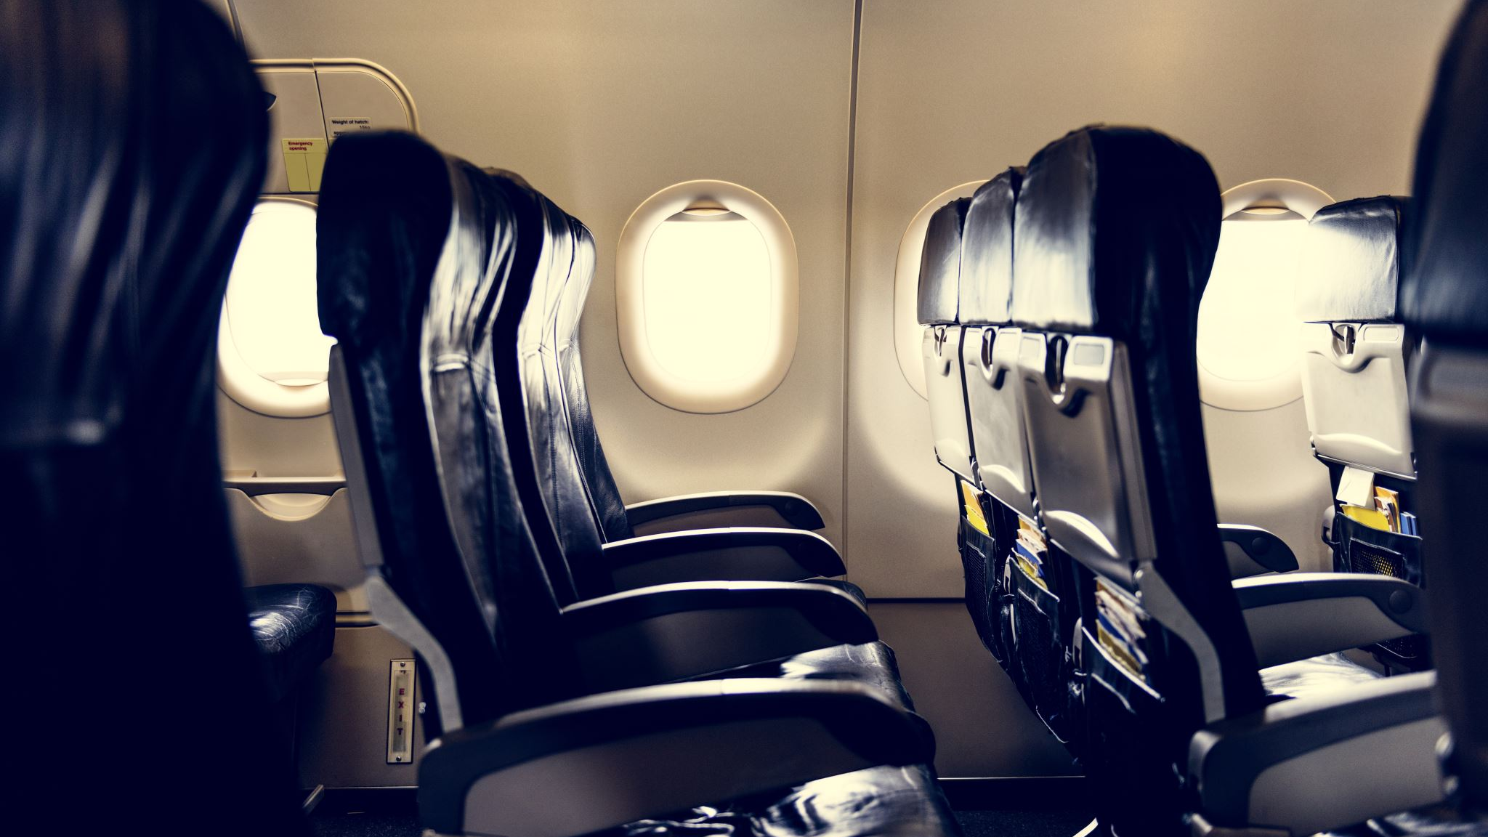
The purpose of this Project – Find the most comfortable flight
Flight Information
Price
Legroom
Amenities

Slide 3
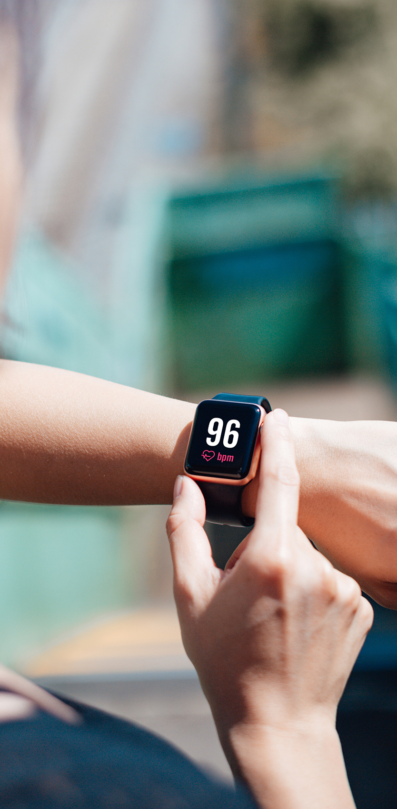
Smart Device Tracking
Sleep tracking
Accelerometer
Heart Rate Sensor
Oximeter

Slide 4

The Dreamline Score
Dreamline Score
Flight information
Smart Device Data
User Feedback

Slide 5
Requirements
Functionality
Dependability
Precision/Accuracy

Slide 6
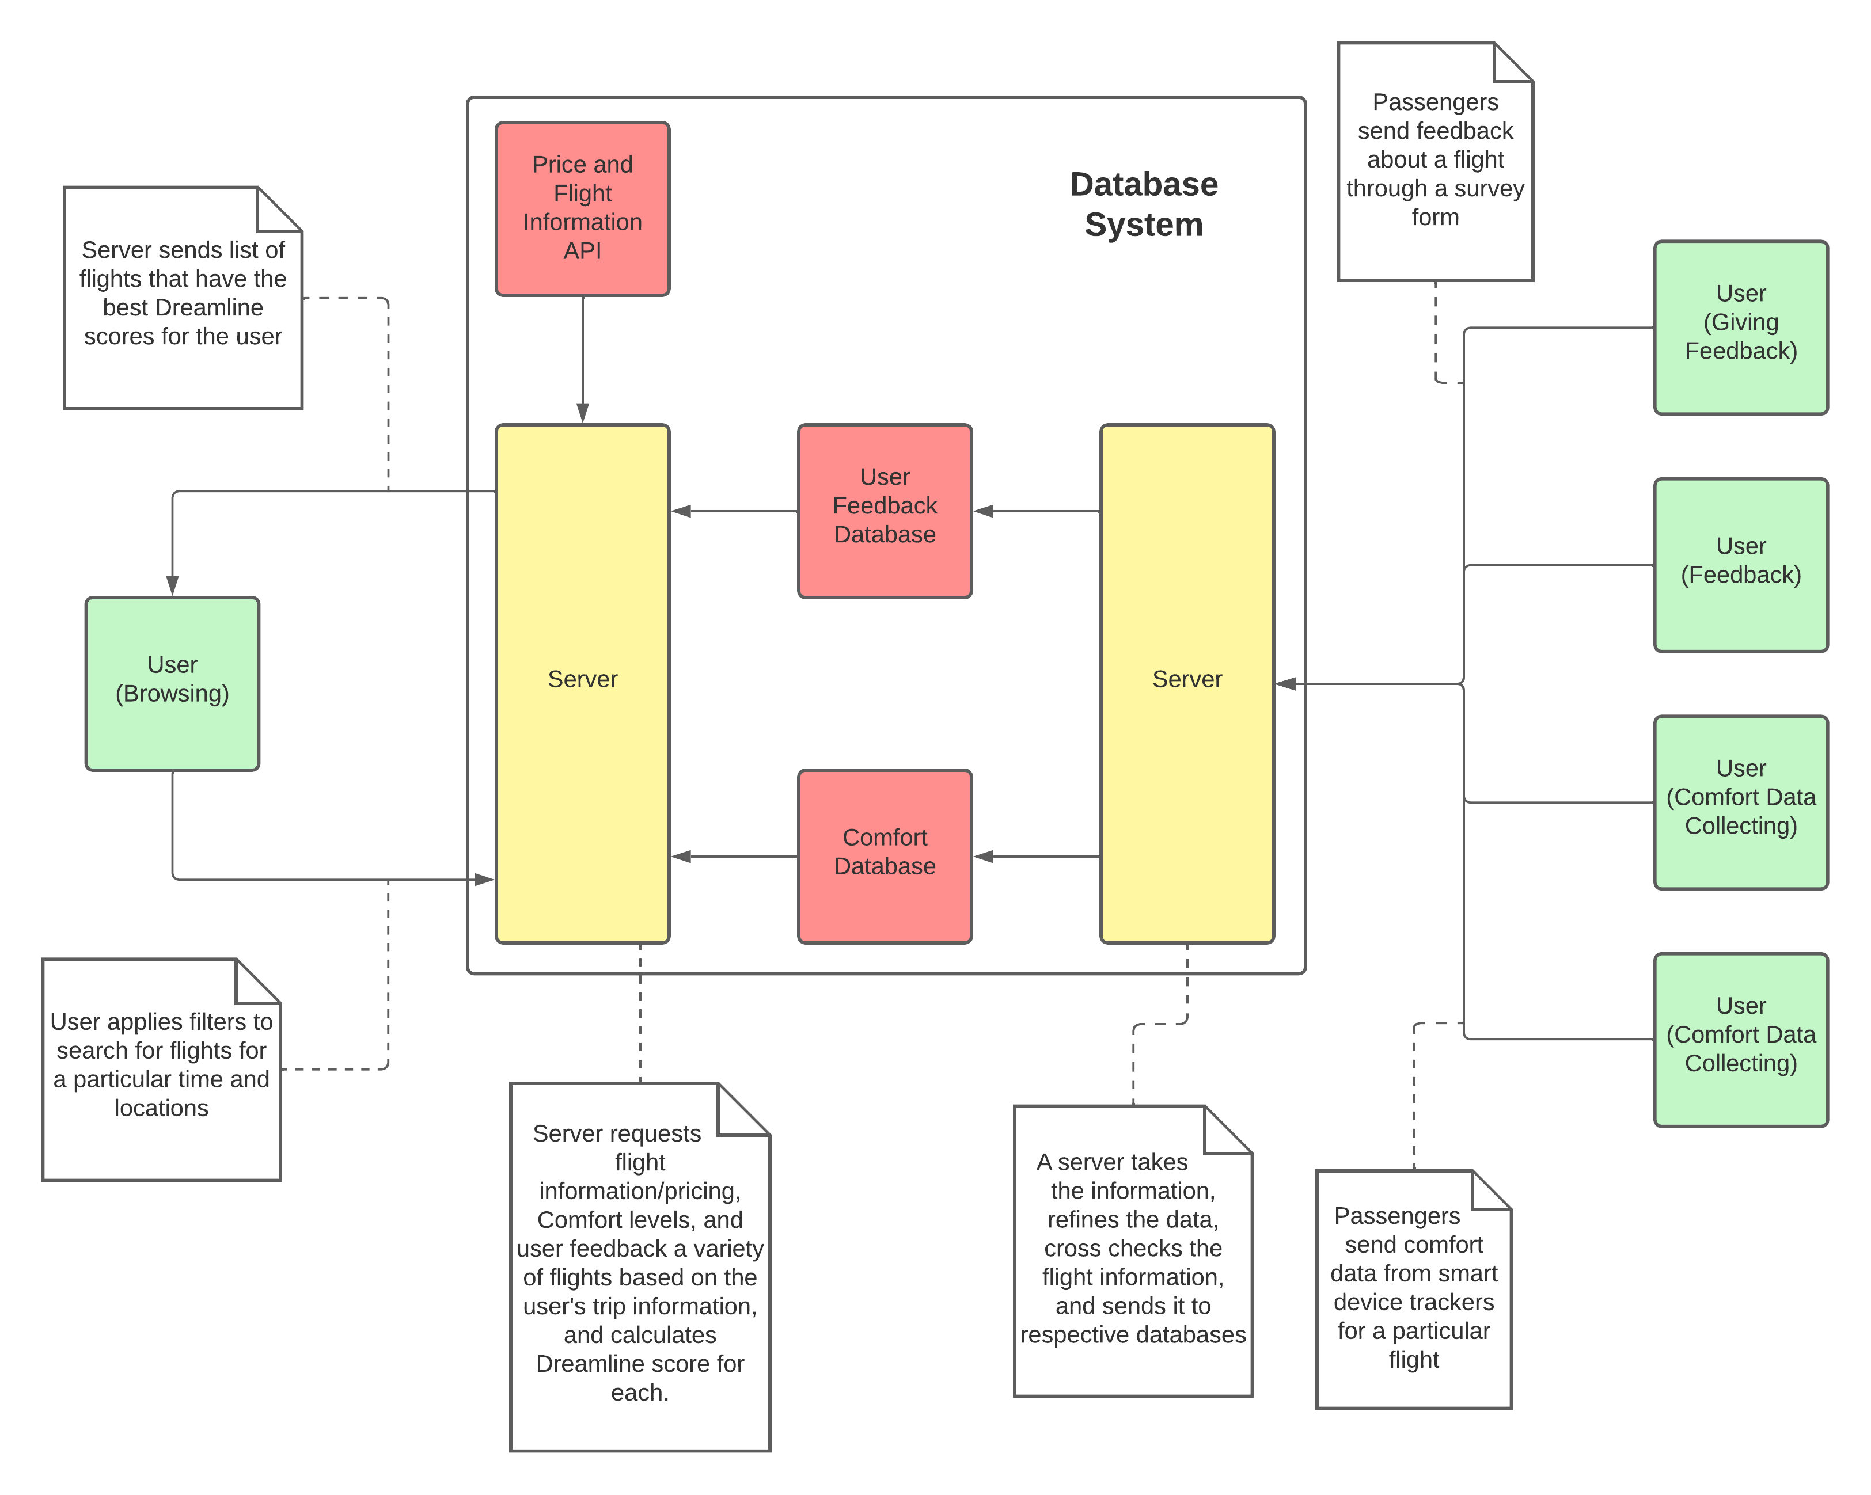
System design

Slide 7
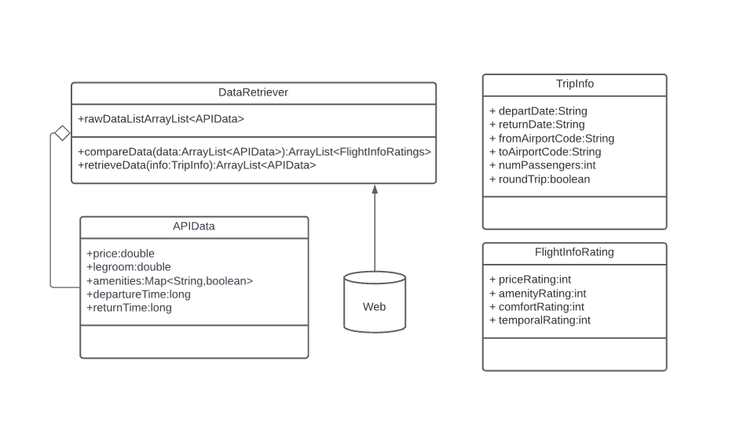
Subsystem: Flight information

Slide 8
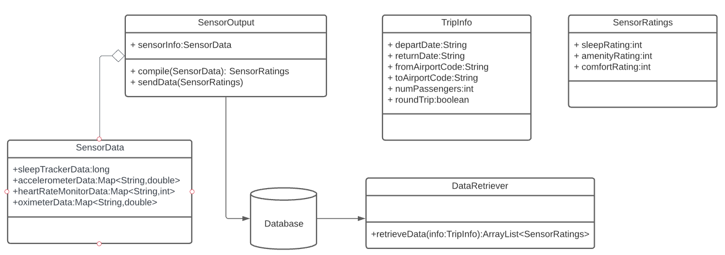
Subsystem: Smart device data

Slide 9
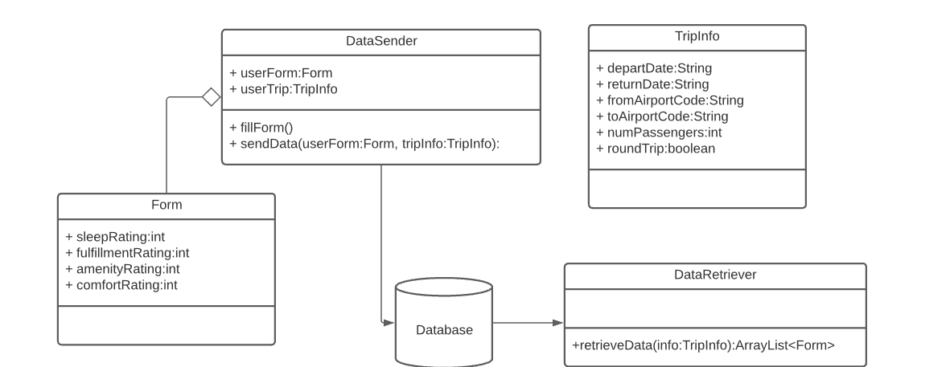
subsystem: User Feedback

Slide 10
Ideas for solutions
Google Flights API
TravelPort API
Smart Device SDKs

Slide 11
bIBLIOGRAPHY
Google Travel, Google, https://www.google.com/travel/flights.
Travelport, 11 Feb. 2022, https://www.travelport.com/products/api.
Google Fit | Google Developers, Google, https://developers.google.com/fit.
Inc., Apple. “Health and Fitness.” Apple Developer, https://developer.apple.com/health-fitness/.

Slide 12

Ready for Takeoff!

